Slide 1
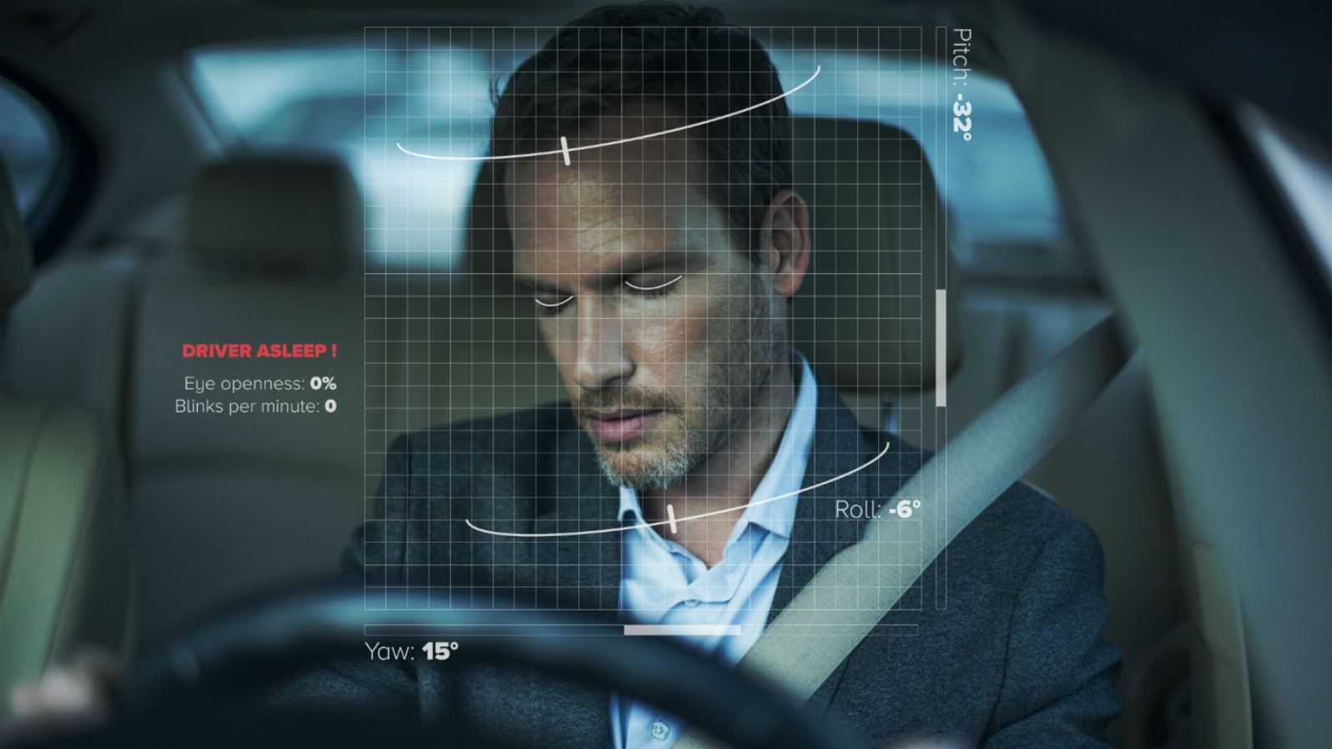
DROWSINESS DETECTION SYSTEM FOR DRIVERS.

Slide 2
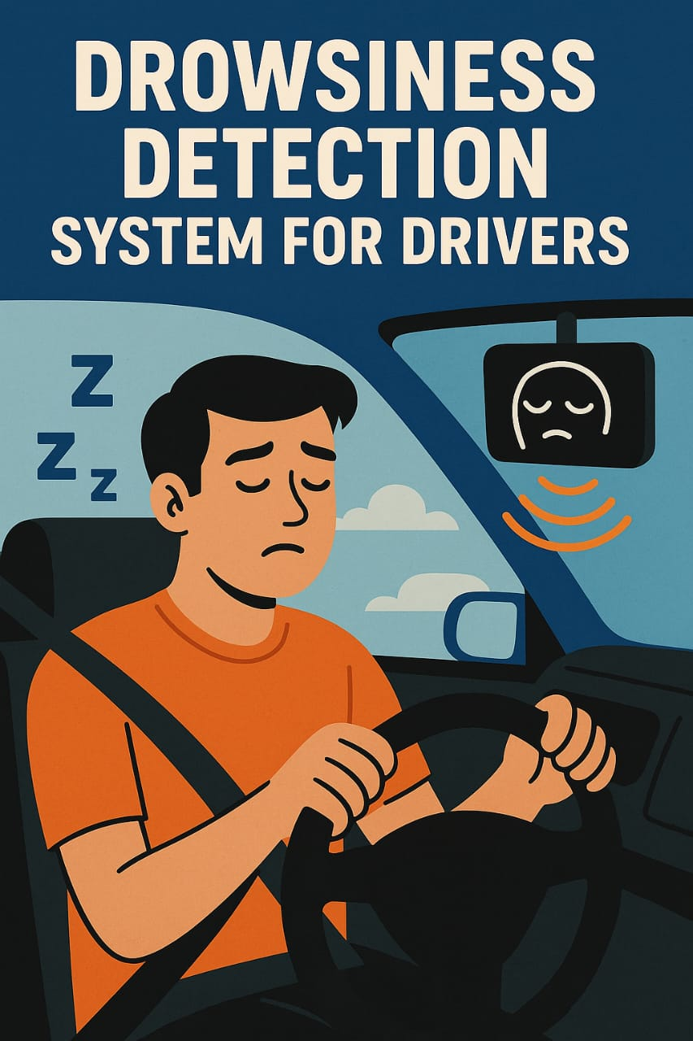

Slide 3
jtf
Abstract:
Driver fatigue is one of the major causes of accidents in the world. Detecting the drowsiness of the driver is one of the surest ways of measuring driver fatigue. In this project we aim to develop a prototype drowsiness detection system. This system works by monitoring the eyes of the driver and sounding an alarm when he/she is drowsy.
The system so designed is a non-intrusive real-time monitoring system. The priority is on improving the safety of the driver without being obtrusive. In this project the eye blink of the driver is detected. If the drivers‟ eyes remain closed for more than a certain period of time, the driver is said to be drowsy and an alarm is sounded.

Slide 4
jtf
Contents
1.INTRODUCTION
2.PROBLEM STATEMENT
3.LITERATURE SURVEY
4.ARCHITECTURE DIAGRAM
5.SYSTEM DESIGN
6.RESULTS
7.CONCLUSION
8.REFERENCES

Slide 5
INTRODUCTION
Driver fatigue is one of the major causes of accidents in the world. Detecting the drowsiness of the driver is one of the surest ways of measuring driver fatigue. In this project we aim to develop a prototype drowsiness detection system. This system works by monitoring the eyes of the driver and sounding an alarm when he/she is drowsy.
The system so designed is a non-intrusive real-time monitoring system. The priority is on improving the safety of the driver without being obtrusive. In this project the eye blink of the driver is detected. If the drivers’ eyes remain closed for more than a certain period of time, the driver is said to be drowsy and an alarm is sounded.

Slide 6
GOAL AND OBJCETIVE:
Witnessing accidents.
Bringing awareness.
Taking advantage of Technology.
Bringing up Suitable Software.
Include the Software into convenience.
Looking for updating the versions.

Slide 7
PROBLEM STATEMENT:
Despite advancements in vehicle safety technologies, drowsiness while driving remains a major cause of road accidents worldwide. Many existing systems either rely on expensive hardware such as infrared cameras or require constant physical interaction from the driver, making them impractical for everyday use. Furthermore, some solutions fail to detect subtle signs of fatigue like slow blinking or yawning, especially under varying lighting conditions. There is also a lack of integration between detection systems and vehicle control mechanisms, limiting their ability to take preventive action. These limitations highlight the need for a cost-effective, accurate, and user-friendly drowsiness detection system that can operate in real-time and adapt to different driving environments.
NO EYE DETECTION – most critical sign of drowsiness Yawning and nodding are not always practical. Varies from person to person – some may not yawn when they are sleepy sometimes

Slide 8
PROBLEM STATEMENT: PROPOSED SYSTEM
· Real-Time Drowsiness Monitoring The system continuously monitors the driver’s facial landmarks such as eye closure and yawning patterns using a webcam and computer vision techniques.
· Eye Aspect Ratio (EAR) & Yawn Detection Using Python and OpenCV with Dlib, the system calculates the Eye Aspect Ratio (EAR) to detect eye closure and identifies yawns through mouth landmark analysis.
· Alert Mechanism When drowsiness symptoms are detected, the system activates an alert using a buzzer and LED connected via Arduino to immediately warn the driver.
· LCD Display for Status Updates An LCD is used to display real-time status messages like "Awake", "Sleepy", or "Yawning Detected" to provide visual feedback.
· Vehicle Control Integration (Optional Extension) The system is capable of sending wireless signals (via Bluetooth or RF) to a vehicle’s motor controller to slow down, steer left, and stop the car in case of prolonged drowsiness.
· Cost-Effective and Easily Deployable The proposed solution uses low-cost hardware components and open-source libraries, making it feasible for widespread use in personal or commercial vehicles.
· User-Friendly Interface The system is designed to run automatically with minimal user interaction, providing a seamless and safe experience for the driver.

Slide 9
LITERATURE SURVEY:
This survey is done to comprehend the need and prerequisite of the general population, and to do as such, we went through different sites and applications and looked for the fundamental data. Based on these data, we made an audit that helped us get new thoughts and make different arrangements for our task. We reached the decision that there is a need of such application and felt that there is a decent extent of progress in this field too.
There are some research on Drowsiness Detection System for Drivers for the proper outcome of the subject and usage of it. The researches use different approaches for the application and the requirement processes.

Slide 10
LITERATURE SURVEY:
Review of Related Works
Drowsiness Detection Based On Driver Temporal Behaviour(31-March 2021, F. Faraji, F. Lotfi, J. Khorramdel, A. Najafi, A. Ghaffari). In this research YOLOv3 CNN is applied as a pretrained network, which is proved to be utilized as a powerful means for object detection.LSTM (Long-Short Term Memory) neural network is employed to learn driver temporal behaviors including yawning and blinking time period as well as sequence classification. One of the main factors of the temporal behavior is that the driver becomes gradually diverted from the road and road traffic. Hence detection is not always accurate.
A Survey on State of The Art Driver Drowsiness Detection Techniques(1December
2020, FHikmat Ullah Khan).The detection system includes the processes of face image extraction, yawning tendency, blink of eyes detection, eye area extraction etc. The percentage of the eyelid closure of the algorithms over the pupil over time is relatively very low.
Driver Drowsiness Detection(21-09-2020, V B Navya Kiran, Raksha R, Anisoor Rahman, Varsha K N, Dr. Nagamani N P).The detection system includes the processes of face image extraction, yawning tendency, blink of eyes detection, eye area extraction etc. This paper provides a comparative study on papers related to driver drowsiness detection and alert system. It is designed in such a way where system does not continuously record or retain any data.

Slide 11
LITERATURE SURVEY:
The survey conducted as part of this project revealed critical insights into driver behavior, awareness, and concerns related to drowsiness while driving. A significant percentage of respondents admitted to having experienced drowsiness during long drives, with many acknowledging the associated risks such as decreased alertness and delayed reaction times. Most participants agreed that a real-time drowsiness detection system could help reduce the chances of accidents and improve road safety. Additionally, respondents showed interest in features such as alerts through sound, visual indicators, and automatic control interventions. These findings highlight the urgent need for a reliable and accessible drowsiness detection solution to promote safer driving practices.

Slide 12
ARCHITECTURE DIAGRAM:
The architecture of the Drowsiness Detection System for Drivers integrates both hardware and software components to ensure real-time monitoring and timely alerts for driver fatigue. The system is primarily built using a Python-based detection algorithm that utilizes computer vision techniques such as facial landmark detection to monitor the driver’s eye and mouth movements through a webcam. These data points are analyzed to detect signs of drowsiness, such as prolonged eye closure (blinking patterns) and frequent yawning. The detection results are transmitted serially to an Arduino microcontroller, which serves as the control unit. Based on the received signals, the Arduino activates output devices such as an LCD display, a buzzer, and a red LED indicator to alert the driver. For enhanced functionality, the system is also connected wirelessly to a motor-driven car setup. When drowsiness is detected, control signals are sent to slow down the car, steer it slightly left, and bring it to a stop, mimicking real-world safety responses. This modular and layered architecture ensures reliable detection, immediate alerting, and responsive vehicle control to prevent accidents caused by driver fatigue.

Slide 13
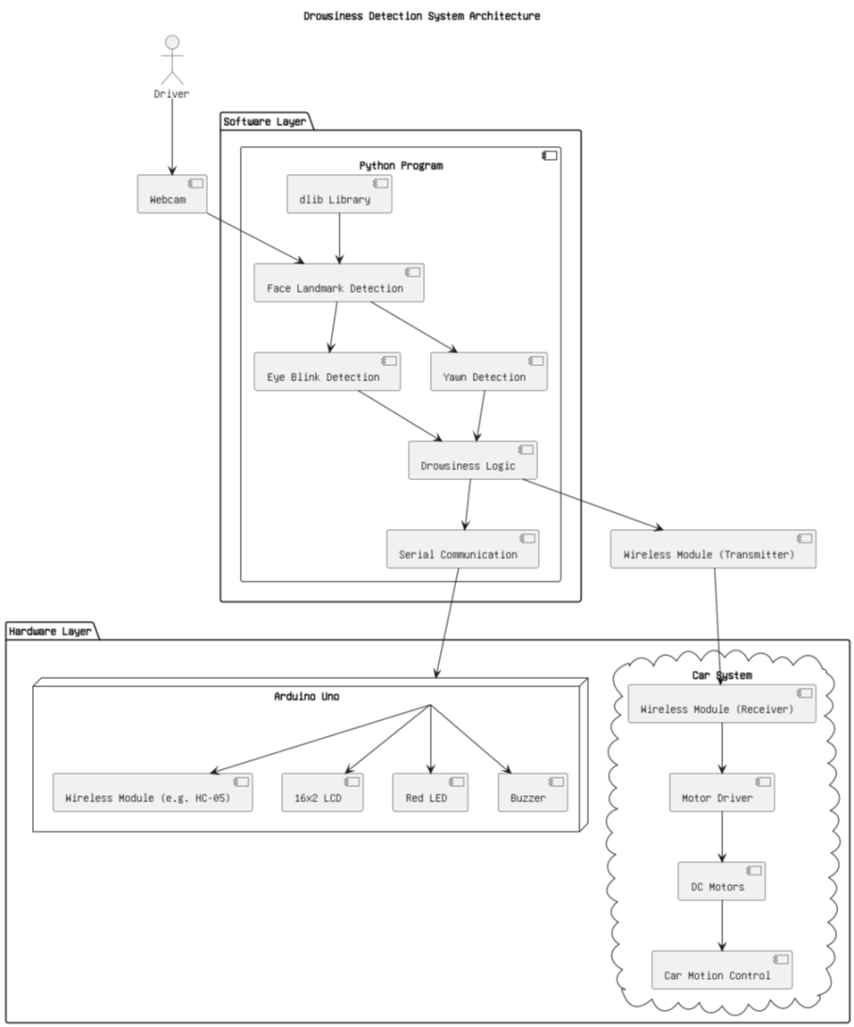
ARCHITECTURE DIAGRAM:

Slide 14
SYSTEM DESIGN:
The Drowsiness Detection System for Drivers addresses the growing concern of road accidents caused by fatigue and drowsiness behind the wheel. The system is designed to detect signs of drowsiness—such as prolonged eye closure and frequent yawning—in real time and alert the driver to prevent potential mishaps. From a technical standpoint, the project is feasible as it leverages open-source tools like Python for image processing and Arduino for hardware-based alert mechanisms. It is operationally practical because the system is non-intrusive, easy to use, and can be integrated into vehicles without complex modifications. Economically, it is cost-effective as it utilizes affordable components such as a webcam, Arduino Uno, buzzer, LED, and LCD. The data flow begins with a live video feed from the camera, which is analyzed using Python’s facial landmark detection techniques. When drowsiness is detected, a signal is transmitted to the Arduino, which then activates a buzzer, red LED, and displays an alert message on the LCD screen. The overall goal of the system is to ensure road safety by continuously monitoring the driver's alertness and delivering timely warnings.

Slide 15
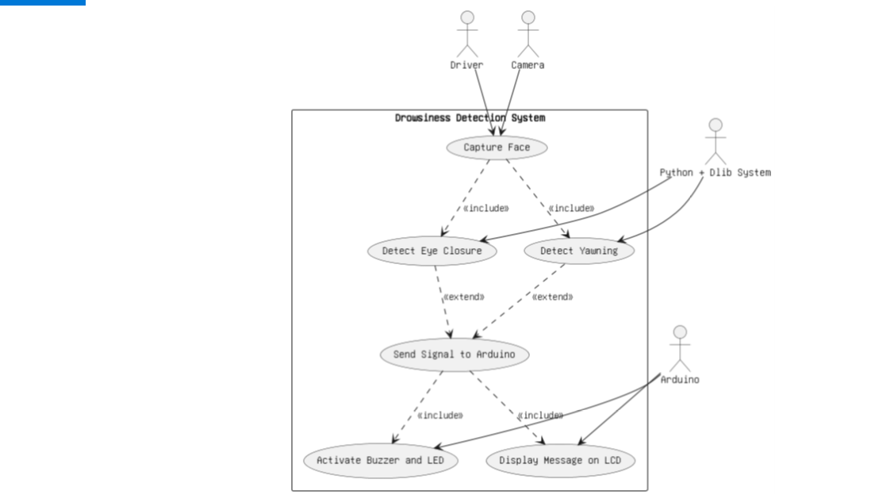
USE CASE DIAGRAM:

Slide 16
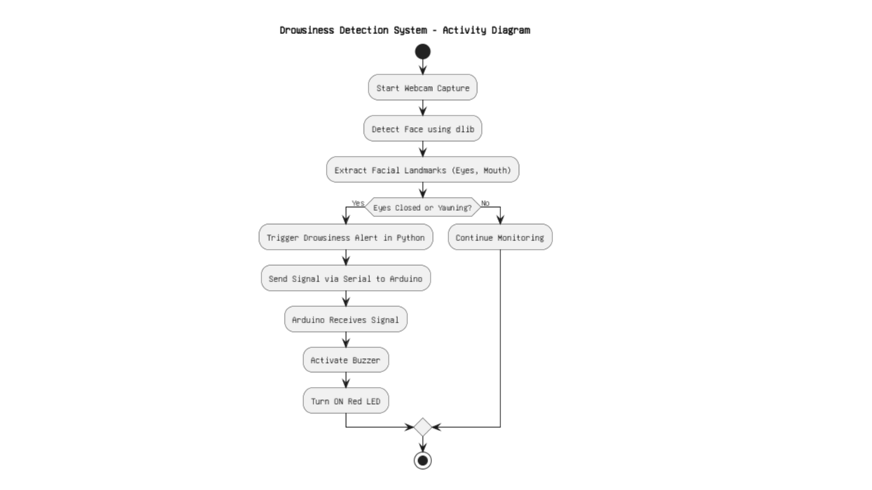
ACTIVITY DIAGRAM

Slide 17
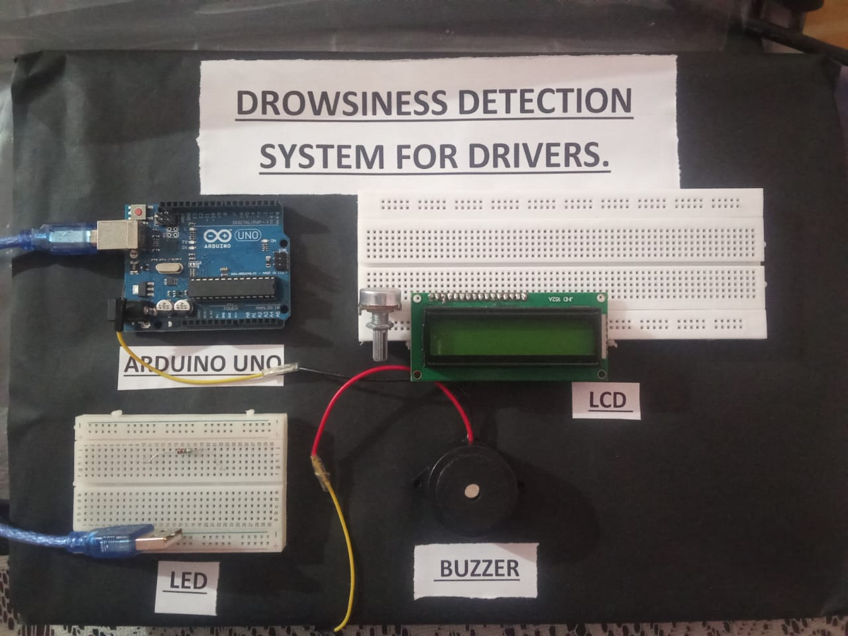
WORKING OF THE PROJECT:

Slide 18
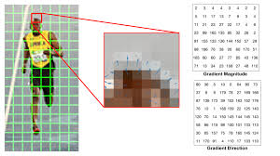
Working of The Project:
Intializing the HOG of dlib(Histogram oriented of Gradients):
Using the Pre_trained HOG of dlib we find the Boundary Box of Coordinates of the image.

Slide 19
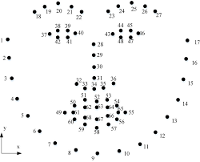
Working of The Project:
Shape_predictor_68_landmark.dat is a Pre Trained Dlib Model Which can Detect 68 landmark points on a HumanFace.

Slide 20
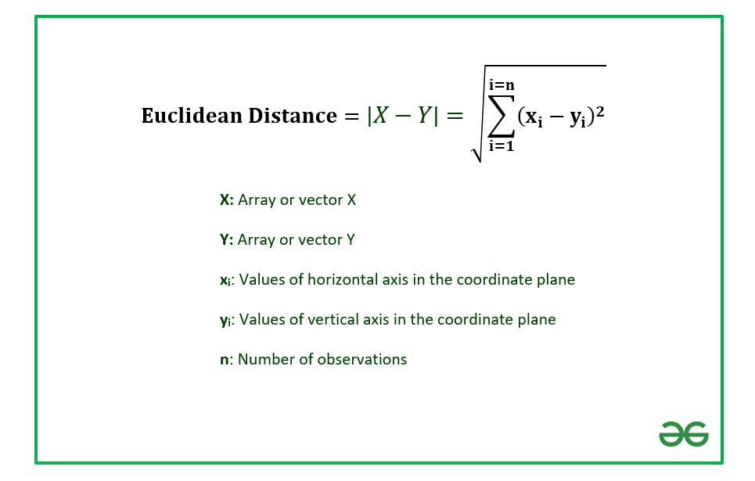
Working of The Project:
Using The Compute function :
Def compute(pt A,pt B):
The function takes two points as input and calculate the Euclidean Distance between these points.
Np.linalg.norm(ptA-ptB)

Slide 21
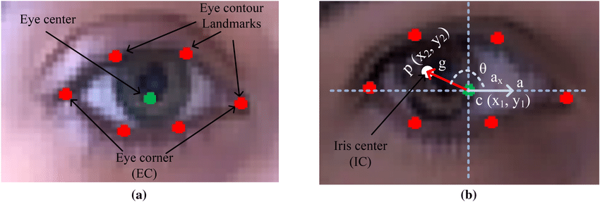
Working of The Project:
Def blinked(a,b,c,d,e,f):
This Blinked Function Takes 6 landmark points particulary of inner eye and outer eye.

Slide 22
Working of The Project:
Up=compute(b,d)+comput(c,e)
The Sum of Vertical Distance of the eye lanmarks points.
Down=compute(a,f):
This is the Horizontal between the right most and leftmost point of the eye.
Ratio=up/(2.0*down+1e-6) EAR (Eye Aspect Ratio is The common Metric used to quantify the eye closure).
If(ratio>0.25) Then The Eyes are considered to be open.
Else if (0.21<ratio<0.25) Then the eyes are considered to be drowsy
If (Ratio<0.21) Then The eyes are Considered to be Closed and Hence the driver is sleeping.

Slide 23
Conclusion:
The Drowsiness Detection System successfully demonstrates how real-time computer vision and embedded systems can be integrated to enhance driver safety. By using Python-based facial landmark detection, the system accurately monitors eye closure and yawning patterns to detect early signs of driver fatigue. Upon detection, it wirelessly communicates with an Arduino-controlled vehicle, initiating a safety protocol that reduces speed, veers the car to the left, and brings it to a halt—potentially preventing accidents.

Slide 24
REFERENCES:
Books
R. Szeliski. Computer Vision: Algorithms and Applications. London: Springer, 2011, pp. 245–265.
S. Russell and P. Norvig. Artificial Intelligence: A Modern Approach. Upper Saddle River, NJ: Prentice Hall, 2010, pp. 570–600.
Book Chapters
J. Redmon. “Real-time object detection and tracking,” in Handbook of Deep Learning Applications, 1st ed., vol. 2. K. Mallick, Ed. New York: CRC Press, 2020, pp. 115–142.
Articles in Journals
S. Arefnezhad and R. Baharlouei. “A new real-time driver drowsiness detection system based on facial expression analysis.” Multimedia Tools and Applications, vol. 80, pp. 30151–30177, Dec. 2021.
N. Jagannath and S. K. Manohar. “Real-time driver drowsiness detection based on eye aspect ratio and yawning detection.” Global Transitions Proceedings, vol. 2, pp. 230–235, 2021.
M. R. Vicente, A. S. Antunes and A. d. S. Soares. “Driver drowsiness detection system using facial features.” Procedia Computer Science, vol. 130, pp. 400–407, 2018.

Slide 25
REFERENCES:
Conference Proceedings
S. Reddy and V. Pujari. “Arduino-based alert system for detecting driver fatigue,” in Proc. IEEE Int. Conf. on Signal Processing, Communication, Power and Embedded System (SCOPES), 2016, pp. 345–349.
A. Tripathi and K. Verma. “Driver drowsiness detection system using computer vision and machine learning,” in Proc. 9th IEEE Int. Conf. on Communication Systems and Network Technologies (CSNT), 2019, pp. 160–165.
D. S. Bindra, M. Jaiswal, and S. Kaushik. “Driver fatigue detection system using convolutional neural network,” in Proc. Int. Conf. on Innovative Computing and Communications (ICICC), 2020, pp. 1023–1030.
Electronic References
Books
S. Calmer. (2020, May 12). AI in Vision-Based Monitoring Systems. (1st edition). [On-line]. 12(4). Available: www.aivisiontech.com/books/monitoring.pdf [Jul. 29, 2025].
Journals
M. Khatri. (2021, Oct.). “Detection of driver fatigue using image processing.” VisionTech Journal. [On-line]. 4(2), pp. 88–95. Available: www.visiontechjournals.org/articles/driver-fatigue [Jul. 29, 2025].

Slide 26
Thank you

